Slide 1

Frito-lays Employees statistics
An analysis of employees on Attrition and Salary
Prepared by Ravi Sivaraman

Slide 2
Introduction
Frito-Lays CFO presented a sample of anonymized data for statistical analysis.
Goal of the statistical analysis are:
Find the attributes that may contribute on why employee may leave
Predict if certain employee may leave, so Frito-Lays may work with retaining them.
Find the salary prediction of employees that are aligned with old employees.

Slide 3
Statistical Data
The data contained lot of variables for an employee that are both private and confidential.
There were 840 employees included.
The data was complete, with no necessary correction.
The data is normally distributed.

Slide 4
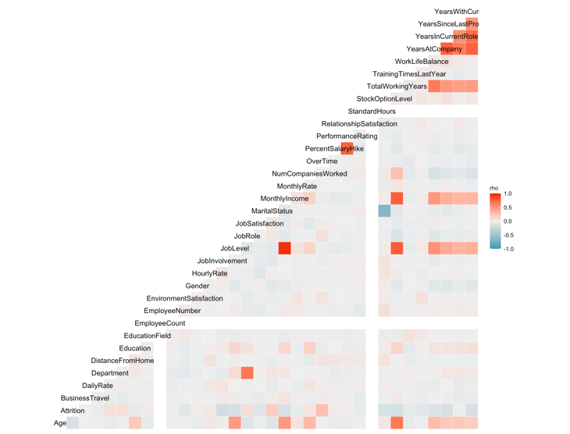
Statistical Data
The following attributes are positively correlated according to the estimate from the given data:
1. Department
2. Distance From Home
3. Job Level
4. Marital Status
5. Number of companies worked
The following are negatively correlated according to the estimate from the given data:
1. Gender
2. Hourly Rate
3. Job Satisfaction
4. Monthly Income
There were more less correlation estimated, but those will be taken into account in our model.

Slide 5
Employee Attrition
Attrition rate with the given data is 16.1%
this is higher than national average for large enterprises.
10% may be ideal attrition rate
Higher attrition rates may negatively affect company.

Slide 6
Prediction of Attrition
With the given data, we built models that accurately estimate if any given employee may leave company.
This is predicted using analysis of known attrition rate.
Models
We built two models: KNN and Naïve Bayes
They are standard models that are used in the industry.
KNN model looks at the nearest neighbor and predicts if the given employee may leave or not.
Naïve Bayes uses Bayes algorithm uses the independent predictors and creates a model to estimate

Slide 7
Attrition Comparison

Slide 8
KNN vs Naïve Bayes

Slide 9
Salary Prediction
With the given data, we estimated the salary of the new set of employees
This is using regression method.
Regression method identifies the estimated variables that likely affect salary for the given data.
Esimated MonthlySalary =
1.838e+02 * BusinessTravel
-7.302e+02 Department
- DistanceFromHome 1.549e+01
+ 3.822e+03 * JobLevel +1.110e+02 * JobRole + TotalWorkingYears * 6.613e+01
- YearsWithCurrManager * 4.466e+01

Slide 10
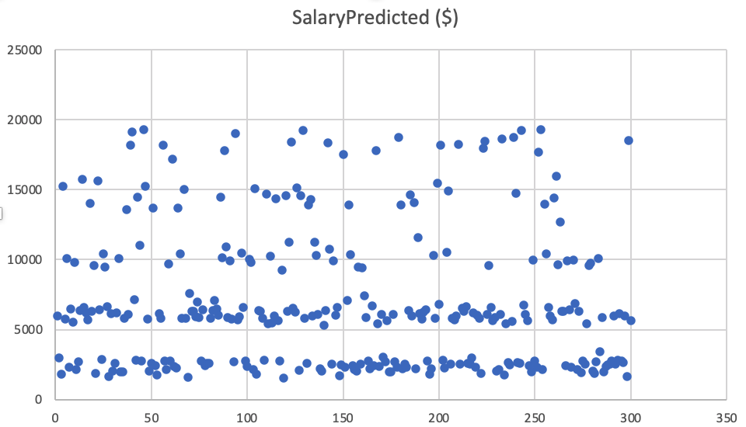
Salary Predicted

